Slide 1
Soil nitrogen availability increases the positive effect of aridity on water use efficiency
Evan A. Perkowski; Nicholas G. Smith
Texas Tech University

Slide 2
Leaf nitrogen is a common surrogate for estimating leaf-level photosynthetic capacity
Evans (1989) Oecologia
Notes:
This figure is from John Evans’ work in 1989 on relationships between leaf nitrogen and C3 photosynthesis.
On the x-axis is leaf nitorgen measured on a leaf area basis and on the y-axis is light-saturated photosynthesis, also measured on an area basis
The different shaped points represent different C3 species.
You can see that within each species, there is generally a tightly correlated and positive relationship between leaf nitrogen and light saturated photosynthesis
This is because a rather large fraction of leaf nitrogen gets allocated toward enzymes, such as Rubisco, that move photosynthetic reactions forward

Slide 3
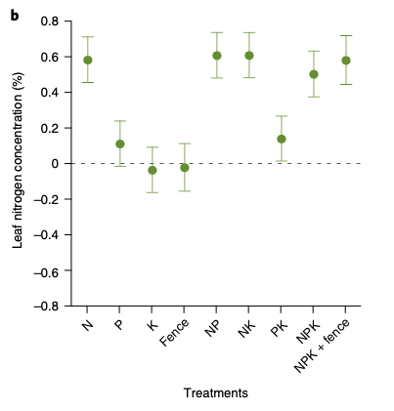
Soil nitrogen has been shown to positively influence leaf nitrogen
Firn et al. (2019) Nature
Notes:
Soil nitrogen has been shown to positively influence leaf nitrogen in a fair share of studies.
This figure is from a study by Jenn Firn in 2019 using a globally coordinated nutrient addition experiment by the name Nutrient Network.
In these experiments, nitrogen, phosphorus, and potassium are added in a full-factorial field manipulation in grassland systems
On the x-axis is the different combinations of nutrient additions, and on the y-axis is leaf nitrogen concentrations

Slide 4
Soil nitrogen has been shown to positively influence leaf nitrogen
Plots that received nitrogen had higher leaf nitrogen content
Firn et al. (2019) Nature
Notes:
You can see that there is a pretty obvious increase in leaf nitrogen content in plots that receive nitrogen fertilizer regardless of potassium and phosphorus combinations

Slide 5
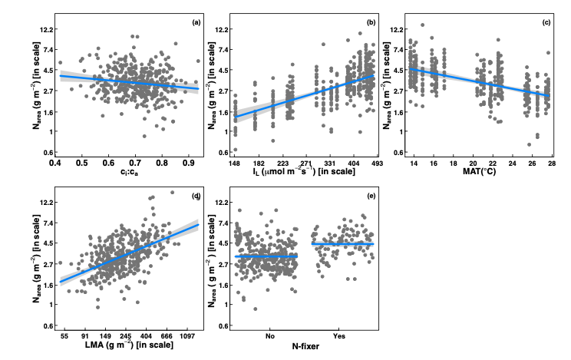
However, leaf nitrogen can also be predicted independent of soil nitrogen
Dong et al. (2017) Biogeosciences
Notes:
Some recent work has also shown that leaf nitrogen can be predicted independent of soil nitrogen availability
This is work from Ning Dong showing on the top row in panel b and c that leaf nitrogen can be predicted from photosynthetically active radiation, which is basically light, and mean annual temperature.
Additionally, they show in panel a that leaf nitrogen can be predicted by the ratio of intercellular carbon dioxide to extracellular carbon dioxide, or Ci:Ca,
In panel d, they show that leaf nitrogen can be predicted through the ratio of intercellular carbon dioxide to atmospheric carbon dioxide, and in panel e show that leaf nitrogen can be predicted on the basis of whether a species can associate with nitrogen-fixing bacteria
Thus, aboveground climate and leaf traits can be used to predict patterns of leaf nitrogen

Slide 6
Leaf nitrogen is likely a product of plant allocation responses to soil nitrogen and climate
Notes:
While we know that variation in leaf nitrogen can be explained by soil nitrogen availability, climate, or plant traits, we still do not have a firm grasp of what drives leaf nitrogen content.
It is possible that these patterns are driven by plant allocation responses to soil nitrogen and climate, but we lack data that links these responses to physiological processes that range from the leaf to whole plant level
Yet, we do not fully understand when and where soil nitrogen impacts nitrogen allocation to leaf tissue vs. other tissues

Slide 7
Photosynthetic least-cost theory provides a framework for understanding when and where

Slide 8
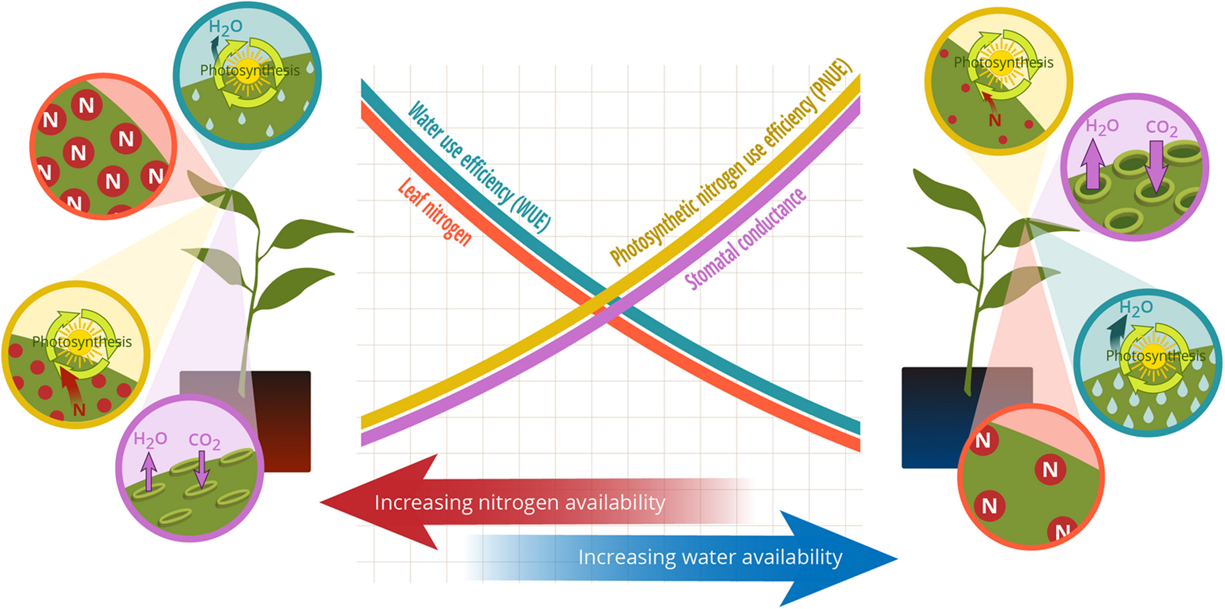
Photosynthetic least-cost theory: leaf nitrogen allocation driven by summed resource use costs
Bialic-Murphy et al. (2021) Ecol. Letters
Notes:
There are two allocation pathways that could alter leaf nitrogen allocation.
At the leaf level, plants might allocate nitrogen to photosynthetic leaf tissue in order to preserve water
This option can be explained through recent frameworks suggesting that plants can and should maximize photosynthetic carbon gain by trading inefficient use of an abundant resource for efficiency a more limited limiting resource.
For example, if nitrogen is relatively more available than water, then plants can maintain a similar photosynthetic output by increasing nitrogen allocation toward photosynthetic leaf tissue in order to increase water-use efficiency., effectively employing a water-savings mechanism
We might expect these patterns would be observed in arid systems where water is relatively less available than nitrogen, although these patterns haven’t necessarily been tested in temperate regions

Slide 9
Hypotheses
Soil nitrogen availability
Leaf nitrogen allocation
Aridity
Water use efficiency

Slide 10
Study system
Notes:
We used the following field manipulation experiment to investigate whether changes in soil resource availability influenced leaf quantity/quality tradeoffs or water/nitrogen use tradeoffs.
Starting in 2010, our coauthor Christy Goodale set up a full-factorial nitrogen-by-sulfur field manipulation experiment at three sites in a contiguous closed canopy forest all within a 20-km radius of Ithaca, New York
This experiment was originally created to tease apart the impacts of soil pH change and soil nitrogen fertilization on forest ecosystem functions;
however, because sulfur additions acidify the soil and promote nitrogen losses over time, this system provides a unique soil nitrogen availability gradient to test our hypotheses

Slide 11
Leaf collection methods

Slide 12
Leaf analyses

Slide 13
Fig. 1

Slide 14
Fig. 2

Slide 15
Fig. 3

Slide 16
Major takeaways

